Slide 1
TIME SPEED & DISTANCE

Slide 2
TIME SPEED & DISTANCE
Time Speed & Distance
Introduction
Relation between time, speed and distance, Conversion of speed from m/s to km/h and vice versa
Concept of average speed & relative speed
Concept of early and late to office and miscellaneous questions

Slide 3
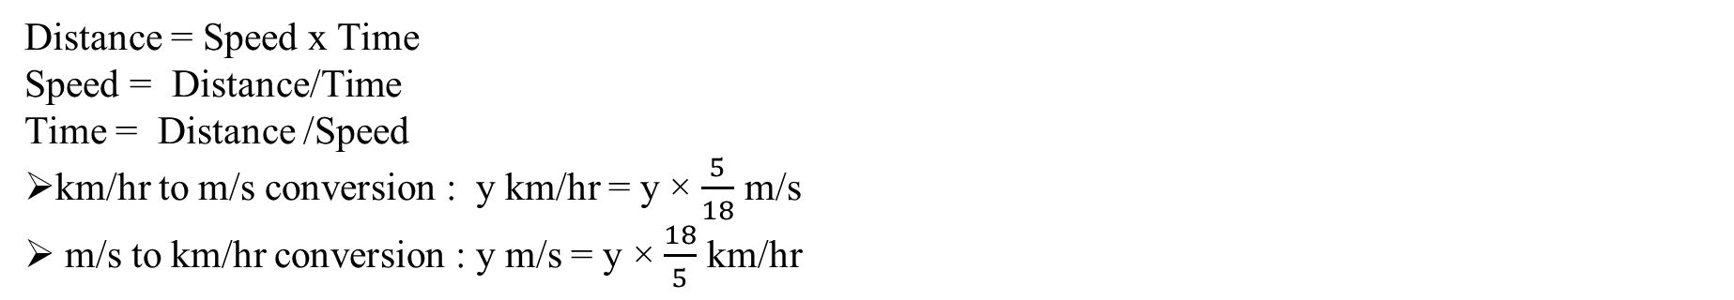
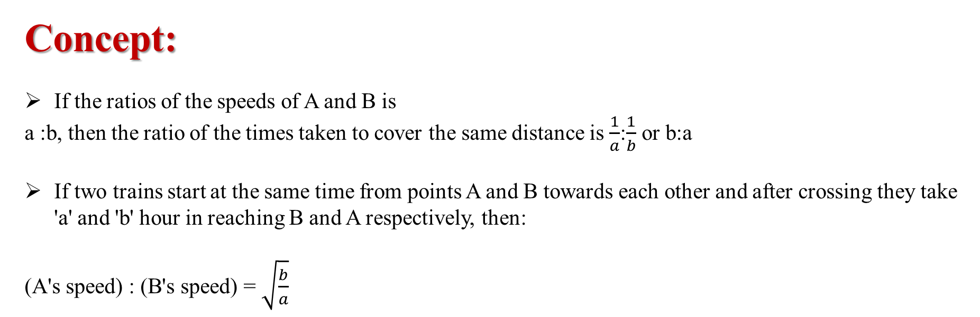
TIME SPEED & DISTANCE
Distance = Speed x Time
Speed = Distance/Time
Time = Distance /Speed
km/hr to m/s conversion : y km/hr = y × $\frac{5}{18}$ m/s
m/s to km/hr conversion : y m/s = y × $\frac{18}{5}$ km/hr
Concept:
If the ratios of the speeds of A and B is
a :b, then the ratio of the times taken to cover the same distance is $\frac{1}{a}$:$\frac{1}{b}$ or b:a
If two trains start at the same time from points A and B towards each other and after crossing they take 'a' and 'b' hour in reaching B and A respectively, then:
(A's speed) : (B's speed) = $\sqrt{\frac{b}{a}}$

Slide 4
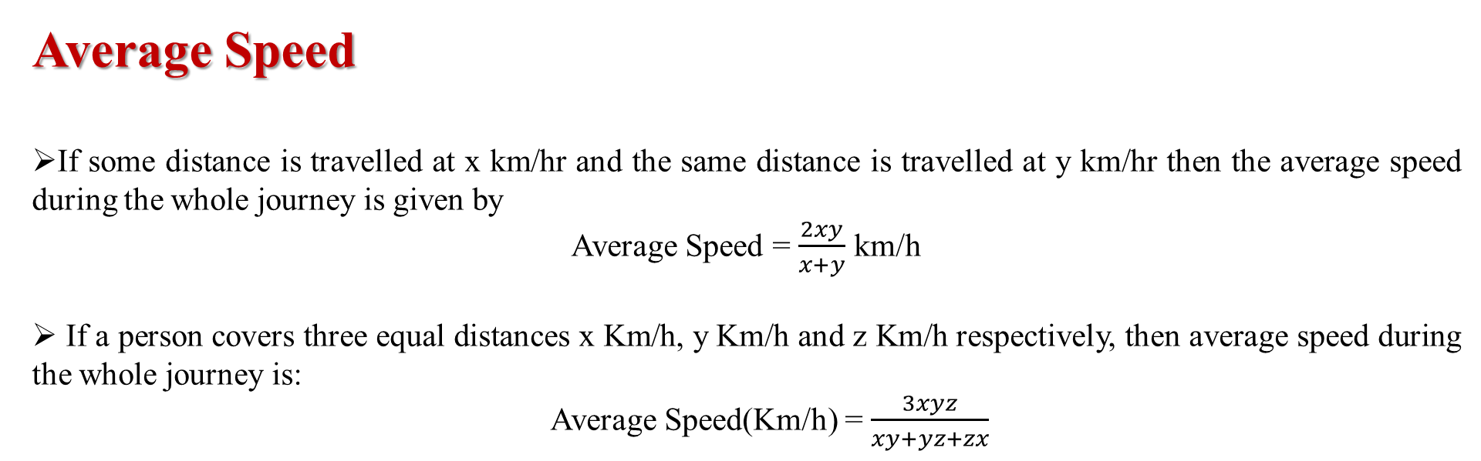
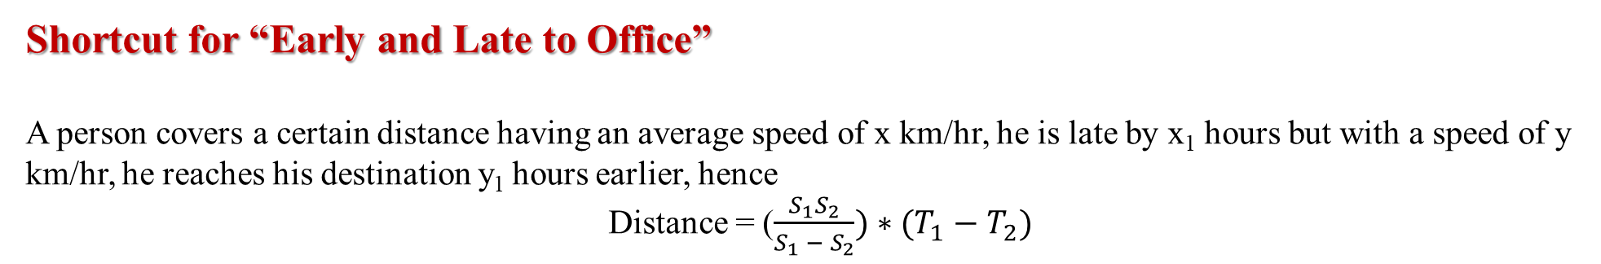
TIME SPEED & DISTANCE
Average Speed
If some distance is travelled at x km/hr and the same distance is travelled at y km/hr then the average speed during the whole journey is given by
Average Speed = $\frac{2xy}{x+y}$ km/h
If a person covers three equal distances x Km/h, y Km/h and z Km/h respectively, then average speed during the whole journey is:
Average Speed(Km/h) = $\frac{3xyz}{xy+yz+zx}$
Shortcut for “Early and Late to Office”
A person covers a certain distance having an average speed of x km/hr, he is late by x₁ hours but with a speed of y km/hr, he reaches his destination y₁ hours earlier, hence
Distance = ($\frac{S_{1}S_{2}}{S_{1} − S_{2}}){∗(T}_{1}− T_{2})$

Slide 5
TIME SPEED & DISTANCE
1. A man goes to his office from his house at a speed of 4 km/hr and returns at a speed of 5 km/hr. If he takes 9 hours in going and coming, what is the distance between his office and house ?
A. 30 km
B. 50 km
C. 20 km
D. 40 km
Notes:
Difficulty level : Easy(Compulsory)
Option C

Slide 6
TIME SPEED & DISTANCE
2. A salesman travels a distance of 100 km in 2 hours and 30 minutes. How much faster, in kilometers per hour, on an average, must he travel to make such a trip in 5/6 hour less time?
10
20
30
40
None of these
Notes:
Difficulty level : Easy(Optional)
Option B

Slide 7
TIME SPEED & DISTANCE
3. If a cyclist starts at 7 km/hr and he increases his speed in every 4 hours by 1 km/hr then the time taken by the cyclist to cover 116 km is?
27/2 hours
20/3 hours
12 hours
14 hours
Notes:
Difficulty level : Easy(Compulsory)
Option D

Slide 8
TIME SPEED & DISTANCE
4. A person has to cover a distance of 8 km in 50 minutes. If he covers one-half of the distance in two-fifth of the total time, to cover the remaining distance in the remaining time, what should be his speed in km/hr?
A. 12 km/hr
B. 10 km/hr
C. 14 km/hr
D. 8 km/hr
Notes:
Difficulty level : Easy(Compulsory)
Option D

Slide 9
TIME SPEED & DISTANCE
5. A man travels a distance of 48 km at 4 km/hr. Another distance of 48 km at 12 km/hr and a third distance of 48 km at 16 km/hr. His average speed for the whole journey is?
7.57 km/hr
9.63 km/ hr
8.75 km/hr
10 km/hr
Notes:
Difficulty level : Easy(Compulsory)
Option A

Slide 10
TIME SPEED & DISTANCE
6. A boy rides his bicycle 20 km at an average speed of 12 km/hr and again travels 15 km at an average speed of 10 km/hr. His average speed for the entire trip is approximately?
10.4 km/hr
10.8 km/hr
11 km/hr
12.2 km/hr
Notes:
Difficulty level : Easy(Compulsory)
Option C

Slide 11
TIME SPEED & DISTANCE
7. The average speed of a bus was slowed down by 10 km/hr due to bad weather in the journey. As a result, the bus reached the destination by 30 minutes late. If the total distance was 550 km, find the normal time required to reach the destination.
4 hours
1 hours
5 hours
2.4 hours
6 hours
Notes:
Difficulty level : medium(Optional)
Option C

Slide 12
TIME SPEED & DISTANCE
8. Arun is travelling on his cycle and has calculated to reach point A at 3 pm if he travels at 10 kmph. He will reach there at 12 noon if he travels at 15 kmph. At what speed must he travel to reach A at 4 pm?
A. 12 kmph
B. 10 kmph
C. 9 kmph
D. 14 kmph
Notes:
Difficulty level : medium(Compulsory)
Option C

Slide 13
TIME SPEED & DISTANCE
9. It takes eleven hours for a 600 km journey, if 120 km is done by train and the rest by car. It takes 40 minutes more, if 200 km is done by train and the rest by car. What is the ratio of the speed of the train to that of the car?
A. 1:2
B. 1:3
C. 3:4
D. 2:3
Notes:
Difficulty level : Expert(Compulsory)
Option D

Slide 14
TIME SPEED & DISTANCE
10. A train can travel 50% faster than a car. Both start from point A at the same time and reach point B 84 kms away from A at the same time. On the way, however, the train lost about 14 minutes while stopping at the stations. The speed of the car is?
100 kmph
110 kmph
120 kmph
130 kmph
Notes:
Difficulty level : expert
Option C

Slide 15
TIME SPEED & DISTANCE
11. Two persons move towards each other from two places 65 km apart. One moves at a speed of 10 km/hr and other at 8 km/hr. In what time will they be 11 km apart ?
3 hrs
2 hrs
6 hrs
4 hrs
Notes:
Difficulty level : medium
Option A

Slide 16
TIME SPEED & DISTANCE
12. The taxi charges in a city consist of fixed charges and additional charges per kilometer. The fixed charges are for a distance of up to 5 km and additional charges are applicable per kilometer thereafter. The charge for a distance of 10 km is Rs. 350 and for 25 km is Rs. 800. The charge for a distance of 40 km is?
Rs. 800
Rs. 750
Rs. 1000
Rs. 1250
None of these
Notes:
Difficulty level : medium(Compulsory)
Option D

Slide 17
TIME SPEED & DISTANCE
13. Shalini was travelling on one side of the Nellai express way with a constant speed of 120 kmph in his car. Hema was travelling with a constant speed of 80 kmph in the opposite direction. When they crossed each other, Shalini decided to take a U-turn and meet her. But before taking a U turn, Shalini had to travel for another 3 minutes. How long will it take for Shalini to meet Hema? [Assume time taken by Shalini to take U turn is negligible]
A. 29 minutes
B. 28 minutes
C. 30 minutes
D. 33 minutes
E. None of these
Notes:
Difficulty level : Expert(Compulsory)
Option E

Slide 18
TIME SPEED & DISTANCE
14. A man covers certain distance with 3/5 of original speed then reached 20 minutes late. How much time he will take to cover the same distance with the original speed?
12 minutes
15 minutes
20 minutes
16 minutes
30 minutes
Notes:
Difficulty level : Easy(Compulsory)
Option E

Slide 19
TIME SPEED & DISTANCE
15. Anita goes to college at 20 km/h and reaches college 5 minutes late. Next time she goes at 30 km/h and reaches the college 3 minutes earlier than the scheduled time. What is the distance of her college?
A. 16 km
B. 12 km
C. 15 km
D. 8 km
Notes:
Difficulty level : medium(Compulsory)
Option D

Slide 20
TIME SPEED & DISTANCE
16. The distance of the School and house of Suresh is 120 km. One day he was late by 1 hour than the normal time to leave for the college, so he increased his speed by 4 km/h and thus he reached to college at the normal time. What is the changed speed of Suresh?
A. 28 kmph
B. 25 kmph
C. 20 kmph
D. 24 kmph
Notes:
Difficulty level : Expert(Optional)
Option D

Slide 21
Problems on Train
Problems on Train
Concept of point Train (Point Object, Length Object, Relative Speed)
Problems related to cross a pole, train, bridge and platform
Two trains coming from two ends and meeting at a point
DS based on topic

Slide 22
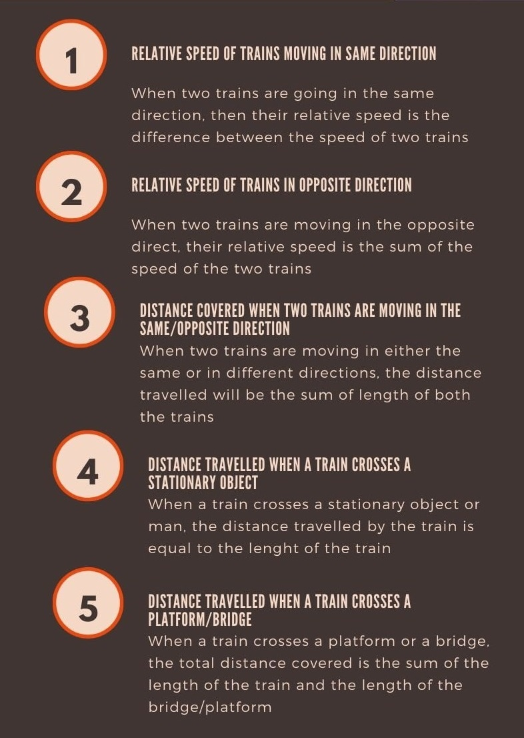
Problems on Train

Slide 23
Problems on Train
If the length of two trains is given, say a and b, and the trains are moving in opposite directions with speeds of x and y respectively, then the time taken by trains to cross each other = {(a+b) / (x+y)}
If the length of two trains is given, say a and b, and they are moving in the same direction, with speeds x and y respectively, then the time is taken to cross each other = {(a+b) / (x-y)}
When the starting time of two trains is the same from x and y towards each other and after crossing each other, they took t1 and t2 time in reaching y and x respectively, then the ratio between the speed of two trains = √t2 : √t1
If two trains leave x and y stations at time t1 and t2 respectively and travel with speed L and M respectively, then distanced from x, where two trains meet is
= (t2 – t1) × {(product of speed) / (difference in speed)}

Slide 24
Problems on Train
1.A train moves past a telegraph post and a bridge 360 m long in 8 seconds and 20 seconds respectively. What is the speed of the train ?
A. 69.5 km/h
B. 100km/h
C. 119km/h
D. 108 km/h
Notes:
Difficulty level:- Easy (Compulsory)
Answer : D
Let the length of the train be x meters and its speed by y m/sec.
Then, x/y = 8 => x = 8y
Now, (x+360)/20 = y
8y + 360 = 20y
y = 30
Speed = 30 m/sec = (30*18/5) km/hr = 108 km/hr.

Slide 25
Problems on Train
2. A train travelling at a speed of 75 mph enters a tunnel 7/2 miles long. The train is 1/2 mile long. How long does it take for the train to pass through the tunnel from the moment the front enters to the moment the rear emerges?
2 minutes
B. 3.2 minutes
C.4.4 minutes
D.5.4 minutes
Notes:
Difficulty level:- Easy (Optional)
Answer: B) 3.2 min Explanation: Total distance covered =(7/2+1/2) =4 miles
Time taken = (4/75)* 60 = 16/5 = 3.2 minutes

Slide 26
Problems on Train
3.The ratio of the speed of two trains is 5:8. Sum of their length is 880. The ratio of time taken to cross an electric pole by train A and B is 4:3. What is the difference between the length of two trains?
A.50m
B.40m
C.80m
D.45m
Notes:
Difficulty level:- Moderate (Compulsory)
Answer: C) 80m Explanation: Ans. Given that length of first train + length of second train = 880 Speed of first train : Speed of second train = 5:8 =5x : 8x Time taken to cross the poll by two trains = 4:3 =4y:3y Now , (5x*4y) + (8x*3y) = 880 44xy = 880 xy = 20 L1 - L2 = 24xy -20xy = 4xy = 80 m

Slide 27
Problems on Train
4. A train of length 4 km is running at a speed of 60 kmph. In what time, it will pass a man who is running 20 km ahead of it with a speed of 20km/h .(in the same direction in which the train is going)?
A. 48 min
B. 54 min
C. 24 min
D. 36 min
Notes:
Difficulty level:- Moderate (Optional)
Answer:D
Relative speed = 60-20=40km/h
Distance the train has to cover to pass a man=4+20=24 km
Now,
T=(24/40)*60 = 36 min

Slide 28
Problems on Train
5.A man sitting in a train which is travelling at 36 kmph observes that a goods train, travelling in opposite direction, takes 10 seconds to pass him. If the goods train is 280 m long, find its speed.?
A.18 m/sec
B.20m/sec
C.15m/sec
D.10m/sec
Notes:
Difficulty level:- Moderate (Compulsory)
Answer: A
Explanation: Speed of normal train =36 x 5/18 m/sec=10m/sec
Let
Sg = Speed of good train
10 =(280)/(sg+10)
Sg=18 m/sec

Slide 29
Problems on Train
6. A 230 meters long train running at the speed of 120 kmph crosses another train running in opposite direction at the speed of 80 kmph in 9 seconds. What is the length of the other train ?
A.270m
B.240m
C.260m
D.320m
Notes:
Difficulty level:- Easy (Optional)
Answer: A) 270 m Explanation: Relative speed = (120 + 80) km/hr
=(200*5/18)m/s = (500/9)m/s
Let the length of the other train be x metres.
Then, x+230/9 = 500/9
=> x + 230 = 500
=> x = 270.

Slide 30
Problems on Train
7. 8 hrs after a goods train passed a station, another train travelling at a speed of 54 km/hr following that goods train passed through that station. If after passing the station the train overtakes the goods train in 13 hours. What is the speed of the goods train?
A.39.6km/h
B.49.5 km/h
C.33.43 km/h
D.26.4km/h
Notes:
Difficulty level:- Easy (optional)
Answer: C
Let Speed of good train =xkm/h
Therefore, Distance travelled by good train in 8 hrs =8x
Speed of another train= 54km/h (given)
Therefore, Relative speed=54-x
Since, T= d/S
Therefore, 13=8x/(54-x) => x=33.43 km/h

Slide 31
Problems on Train
8.Excluding stoppages, the speed of a train is 180 kmph and including stoppages, it is 90 kmph. For how many minutes does the train stop per hour?
A.25
B.40
C.30
D.20
Notes:
Difficulty level:- Easy (Compulsory)
Anwer: C
Because of stoppages, train 90 km less per hour.
Speed of train is 180kmph
It means trains travels 180km in 1hr
Or it travels 1km in 1/180hrs Therefore, Time taken to cover 90 km = 90/180hr=1/2 hrs=1/2 x 60 minutes=30 minutes

Slide 32
Problems on Train
9.Two trains of equal length, running with the speeds of 60 and 40 kmph, take 40 seconds to cross each other if they are running in the same direction. What time will they take to cross each other if they are running in opposite directions ?
A.8 sec
B.10 sec
C.12 sec
D.15 sec
Notes:
Difficulty level:- Easy (Compulsory)
Answer: A) 8 sec Explanation: Relative Speed = 60 -40 = 20 x 5/18 = 100/18 m/s
Time = 40 sec
Distance = 40 x 100/18 = 2000/9
Relative Speed = 60 + 40 = 100 x 5/18
Time = 2000/9 x 18/500 = 8 sec.

Slide 33
Problems on Train
10.A train left 2 hour later than the scheduled time but in order to reach its destination 240 km away in time, it had to increase its usual speed by 20 km/hr. What is the usual speed (in km/hr) of the train?
A.80
B.60
C.48
D.40
Notes:
Difficulty level:- Moderate (Compulsory)
Answer: D
Let Normally train covers journey in t hrs with a speed of s km/h
According to the question
Case 1: (x+20)(t-2)=240 =>10t-x =20........(1)
Case 2: xt =240....................................(2)
By solving equation 1 and 2,we get
Speed of train = 40km/h

Slide 34
Problems on Train
11.Two trains A and B having lengths 110 m and 150m, take 10 seconds and 15 seconds respectively to cross a post. In what time (in seconds) will they cross each other when travelling in opposite direction?(Find approximate answer)
A.10
B.25
C.12
D.20
Notes:
Difficulty level:- Moderate (Optional)
Answer: C
Explanation :Let
Sa=Speed of train A
Sb=Speed of train B
Time taken by A to cross post=110/Sa => Sa=110/10 =11 m/sec (Given,t=10sec)
Time taken by B to cross post =150/Sb =>Sb=150/15 =10m/sec (Given,t=15sec)
Therefore,
Time taken to cross each other =(110+150)/(11+10) =12 sec

Slide 35
Problems on Train
12.Two stations A and B are 100 km apart on a straight track. One train starts from A and travels towards B at 30 kmph. Another train starts from B and travels towards A at a speed of 20 kmph. After how much time will they meet?
A.1 hour
B.1.5 hours
C. 2 hours
D. 3 hours
Notes:
Difficulty level:- Moderate (Optional)
Answer:C
Explanation:
T=Distance between two train/Relative speed
T=100/(30+20)
T=2 hours

Slide 36
Problems on Train
13.Two passenger trains start at the same hour in the day from two different stations and move towards each other at the rate of 16 kmph and 23 kmph respectively. When they meet, it is found that one train has travelled 105 km more than the other one. The distance between the two stations is ?
A.385 kms
B. 595 kms
C. 145 kms
D. 585 kms
Notes:
Difficulty level:- Moderate (Optional)
Answer: D) 585 kms Explanation: When time is constant,
D1:D1=S1:S2
Therefore at point of meeting
D1:D2=16:23
Therefore, D2-D1=23x-16x=7x
It is given D2-D1=105 km
Therefore, 7x =105 => x=15 km
Distance between the station=16x +23x =39x =39 * 15=585 km

Slide 37
Problems on Train
14. Two trains left from two stations P and Q towards station Q and station P respectively. 3 hours after they met, they were 726 Km apart. First train arrived at its destination 25 hours after their meeting and the second train arrived at its destination 36 hours after their meeting. How long did it take for the first train to make the whole trip?
A. 18h
B. 25h
C. 45h
D. None
Notes:
Difficulty level:-Expert (Compulsory)
Answer: D
Let S1:Speed of 1st train
S2:Speed of 2nd train
D:distance between two station P and Q
Since , first train arrived at its destination 36 hours after their meeting and the second train arrived at its destination 25 hours after their meeting.
Therefore, S1:S2=(36:25)^{1/2} =6:5 =>S1=6x ,S2=5x
In 3 hrs, T1 will cover Distance D1=3* 6x=18x , and T2 will cover Distance D2=3* 5x=15x
It is given that, 3 hours after they met, they were 726 Km apart.
Therefore.D1+D2=726 =>33x=726 => x=22km/h
S1=132km/h and S2=110km/h
D=S1*25 +S2 * 36 =3300 +3960 =7260km
Therefore, Time taken by T1 to complete the whole trip =7260/132 =55 hrs

Slide 38
TIME SPEED & DISTANCE
15. Two trucks are travelling towards each other. What is the distance between them just before 30 minutes they meet ?
I ) They were originally 100 km apart
II) Speed of a truck A is 30 km/hr and speed of truck B is 40 km/hr.
A. If Statement I is sufficient for the answer.
B. If Statement II is sufficient for the answer.
C. If Statement I and II are sufficient for the answer but neither of the two alone is sufficient.
D. If Statement I or II is sufficient for the answer.
E. both Statement I and II are insufficient for the answer.
Notes:
Difficulty level : expert(Compulsory)
Option B

Slide 39
TIME SPEED & DISTANCE
16. How long did it take Supriya to drive to her office?
Statement I: If she had driven twice as fast she would have taken 15 minutes.
Statement II: Her average speed was 40 km per hour.
A) If the data in statement I alone is sufficient to answer the question.
B) If the data in statement II alone is sufficient to answer the question.
C) If the data either in statement I alone or statement II alone are sufficient to
answer the question.
D) If the data given in both I and II together are not sufficient to answer the question.
E) If the data in both the statements I and II together are necessary to answer the question.
Notes:
Difficulty level : expert
Option A

Slide 40
Problems on Train
17. Find the speed of the train whose length is 420 metres?
I. The train crosses another train of 510 meters length running in opposite direction in 10 seconds.
II. The train crosses another train running in the same direction at the speed of 60 km/hr in 30 seconds.
A) I alone sufficient while II alone not sufficient to answer
B) II alone sufficient while I alone not sufficient to answer
C) Either I or II alone sufficient to answer
D) Both I and II are not sufficient to answer
E) Both I and II are necessary to answer
Notes:
Difficulty level:-Moderate (Compulsory)
Option: E
Time taken to cross the train, running in opposite directions =(l1+l2)/u+v)=(l1+l2)/(u+v) sec.
⇒10=(420+510)/(u+v)=(420+510)/(u+v) ⇒u+v =93
Time taken to cross the train, running in same direction =(l1+l2)/(u−v)=(l1+l2)/(u−v) sec.
⇒30=(420+510)/(u−60×5/18)=(420+510)/(u−60×5/18) ⇒u =(31+50/3) m/sec.
Thus, u and v can be obtained.
∴∴ Correct answer is (E).

Slide 41
Problems on Train
18.What is the speed of the train?
I. 640 metres long train crosses a signal pole in 18 seconds
II. 720 metres long train crosses a platform in 45 seconds.
A) I alone sufficient while II alone not sufficient to answer
B) II alone sufficient while I alone not sufficient to answer
C) Either I or II alone sufficient to answer
D) Both I and II are not sufficient to answer
E) Both I and II are necessary to answer
Notes:
Difficulty level:-Easy (Optional)
Answer:A
Speed = Length of the train / Time taken to cross the pole =640/18=320/9 m/s.
∴∴ I alone gives the answer.
Time taken to cross the platform = (Length of train + Length of platform) / Speed of the train
⇒⇒ Speed =(720+p)/45=(720+p)/45 m/s.
But, p = length of platform, is not given.
∴∴ II is not sufficient to give the answer.
∴∴ The correct answer is (A).

Slide 42
Problems on Train
19. What is the length of the train XX ?
I. Train XX crosses a telegraph post in 20 seconds.
II. Train XX crosses a platform of length 800 m in 100 seconds.
III. Train XX passes through a tunnel 400 m long in 60 seconds.
A) I and either II or III only
B) II and III only
C) II and either I or III only
D) III and either I or II only
E) Any two of the three
Notes:
Difficulty level:-Easy (Optional)
Time taken to cross a pole = Length of train / Its speed ⇒20
⇒ speed = Length of train/ 20 ---(1)
Time taken to cross a platform =l+800/speed=l+800/ speed
⇒100 =l+800/ speed=l+800/ speed ⇒⇒ speed = l+800/100= l+800/100 ---(2)
Time taken to pass through a tunnel =(l+400)/ 60=(l+400)/ 60
⇒60 = l+400/ speed= l+400/ speed
⇒⇒ speed =l+400/60 ---(3)
Equating any two out of three will give us answer.
=>Correct answer is (E).

Slide 43
Any Doubts???

